Slide 1
CORPORATE TRAINING SYSTEM
SUPERVISOR: Mr. Nguyen Huy Hung
Team member: Le Phuc Thinh
Vo Thach Nguyen
Pham Chanh Hung
Dang The Anh

Slide 2
OUTLINE
Introduction
Implementation
Demostration
Values & Challenges

Slide 3

INTRODUCTION
1
Current Situation
2
Problems
3
Solution

Slide 4
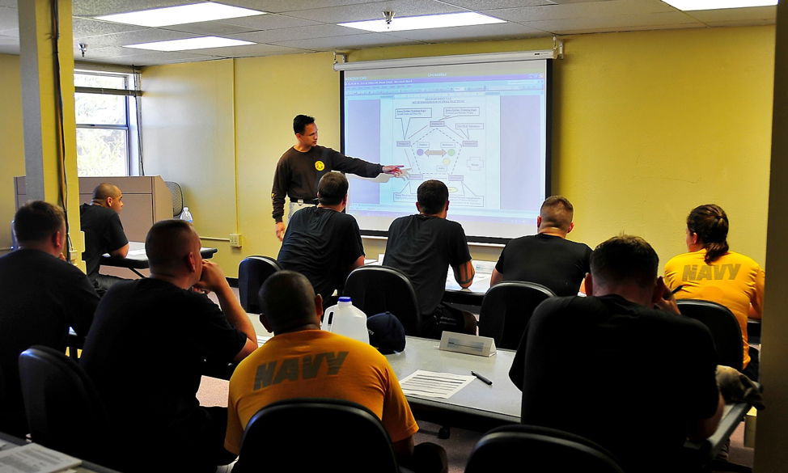
Current situation
Classroom Training
Lack of human resources to conduct classroom courses
The content of course may be duplicated
Students cannot have flexible time to study

Slide 5

Current situation
Self-study
Lack of communication
Holes in knowledge
Knots in your head

Slide 6

Current situation
Share training program online
Lack of privacy on training courses
Loss of Control
User information can be exposed to third party

Slide 7

SOLUTIONS
Provide a system for corporations to train their employees with security and conveniences.
Analyze employees’ studies to make improvements base on results.
Corporations can manage their training plans and users participated in it with ease.

Slide 8
DEMO MANAGER: CREATE plan

Slide 9




PROCESS
1. Open manage plans page
2. Click create plan
Manager
Create plan popup
Manage plans page
3. Input information
4. Change plan image overview
Manage plan

Slide 10
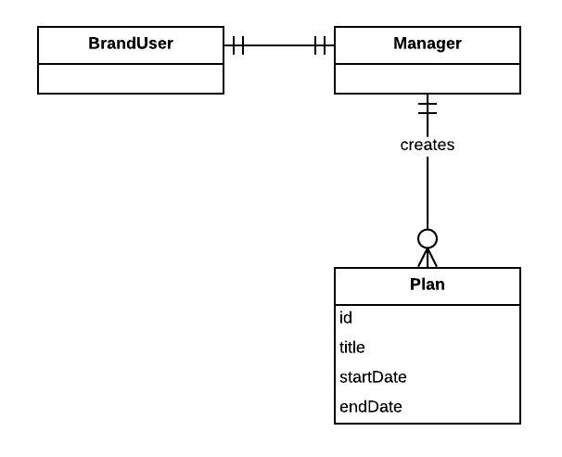
ENTITIes

Slide 11
DEMO author: CREATE LECTURE

Slide 12



PROCESS
1. Open my course list
2. Choose course
Author
Browser
Course
3. Choose section
5. Fill information and click publish
4. Create lecture
Lecture
Section
Notes:
Đầu tiên: tác giả bật traisy web app.
Tiếp theo: tác giả chọn khóa học trong danh sách khóa học của mình, sau đó tác giả bấm thêm bài học cho khóa học đó, , kế tiếp tác giả chỉnh sửa nội dung cho bài học
Cuối cùng: sau khi hoàn tất chỉnh sửa, tác giả lựa chọn “công khai” khóa học

Slide 13
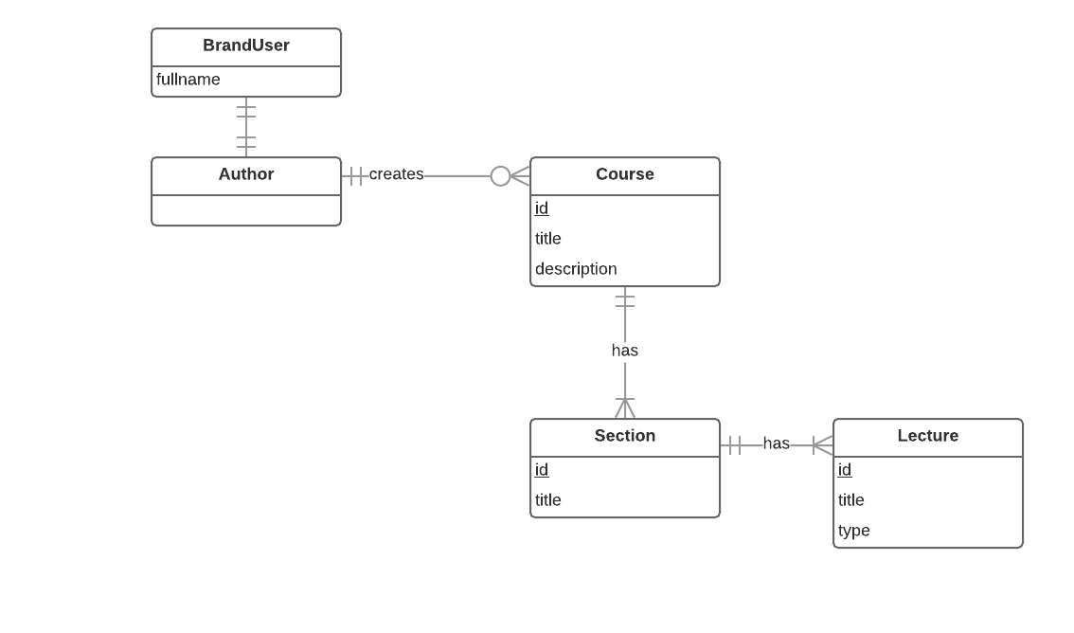
ENTITIes

Slide 14
DEMO author: CREATE quiz

Slide 15



PROCESS
1. Open my course list
2. Choose course
Author
Browser
Course
3. Choose section
6. Create answer
5. Create question
4. Create quiz
Answer
Question
Quiz
Section
Notes:
Đầu tiên: tác giả bật traisy web app.
Tiếp theo: tác giả chọn khóa học trong danh sách khóa học của mình, sau đó tác giả bấm thêm bài học cho khóa học đó, , kế tiếp tác giả chỉnh sửa nội dung cho bài học
Cuối cùng: sau khi hoàn tất chỉnh sửa, tác giả lựa chọn “công khai” khóa học

Slide 16
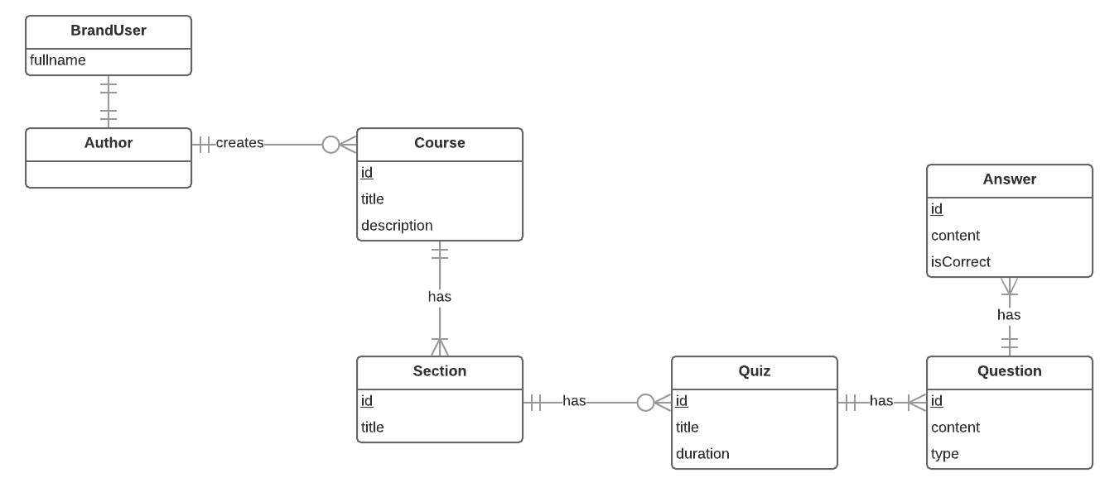
ENTITIes

Slide 17
DEMO author: CREATE COURSE

Slide 18
PROCESS
1. Open list plan
2. Create course
Author
Browser
Course
3. Fill information and click publish

Slide 19
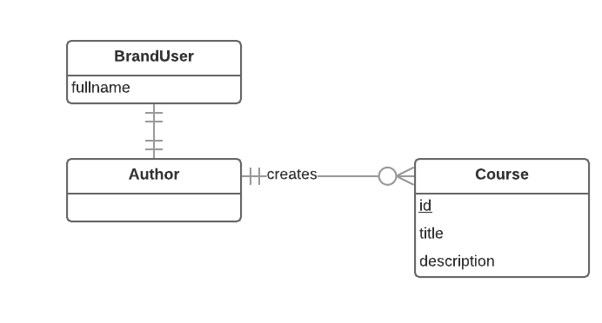
ENTITIes

Slide 20
DEMO LEARNER: LEARN LECTURE

Slide 21
PROCESS
1. Open course page
2. Learn lecture
Learner
Course information page
Lecture
3. Click finish learning lecture

Slide 22
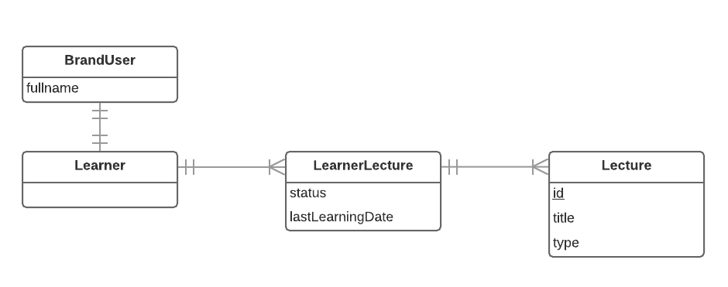
ENTITIes

Slide 23
DEMO LEARNER: TAKE QUIZ

Slide 24
PROCESS
1. Open course page
2. Take a quiz
Learner
Course information page
Quiz
3. Show result of quiz

Slide 25
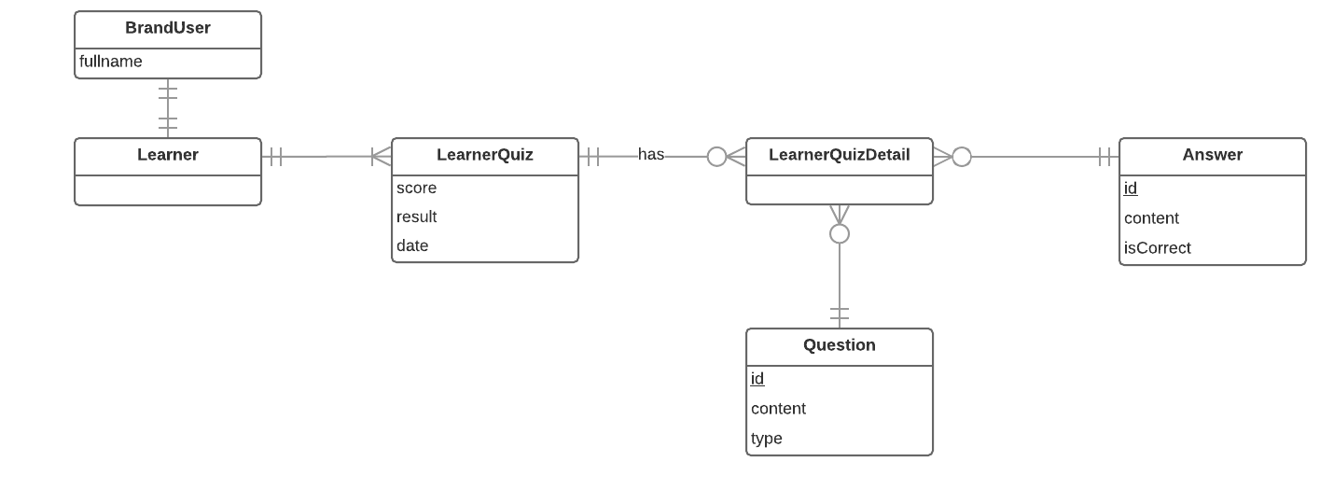
ENTITIes

Slide 26


VALUES
Tightness and clarity. There are different specific training plans, each consisting of programs and courses related to a particular field.
Monitor everything through reports or statistics.

Slide 27

CHALLENGES
Currently only supports the web platform

Slide 28

FUTURE PLANS
Develop and improve system on mobile platforms such as iOS, Android, ...

Slide 29
THANK YOU FOR LISTENING

Slide 30


